Slide 1

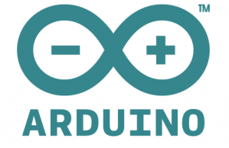

Two Day Workshop on
“SCILAB-ARDUINO”

Slide 2
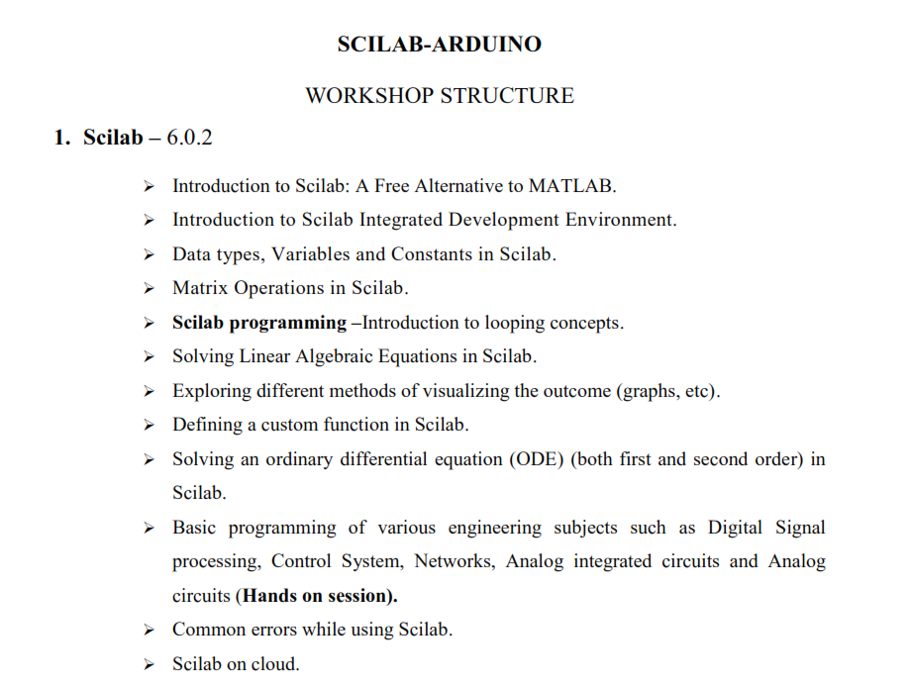

Slide 3
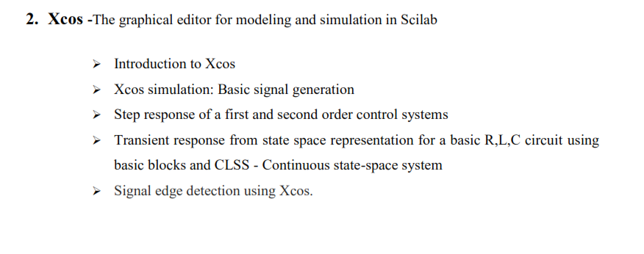

Slide 4
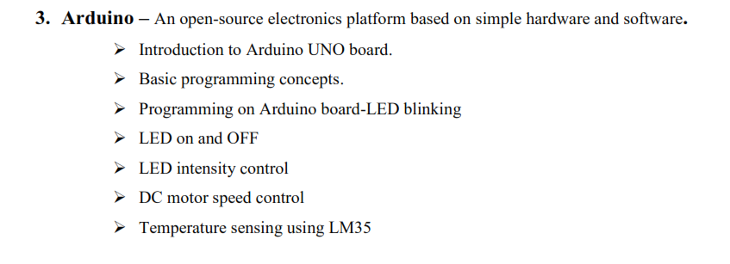

Slide 5
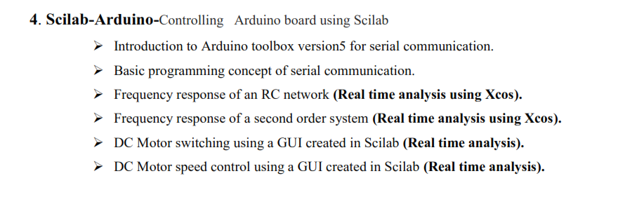

Slide 6
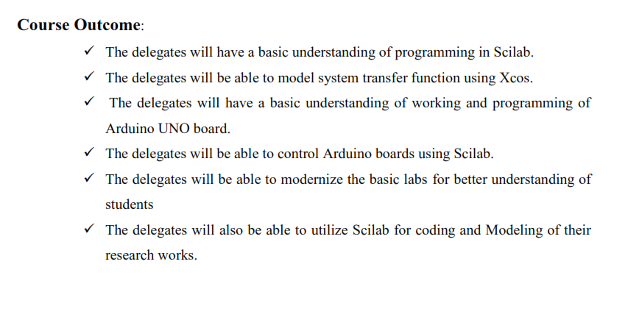

Slide 7
What is SCILAB?
Scilab(Scientific Laboratory) is free and open source software for numerical computation providing a powerful computing environment for Engineering and Scientific applications, which includes mathematical operations and data analysis.
Scilab was created in 1990 by researchers from the French Institute for Research in Computer Science and Control (INRIA). The Scilab Consortium was formed in May 2003 to broaden contributions and promote Scilab as worldwide reference software in academia and industry.

Slide 8
What does SCILAB do ?
The default Scilab installation comes with a basic set of functions for:
Basic mathematical operators (addition, subtraction, multiplication, division, etc.)
Logical operations (AND, OR, NOT, etc.)
Basic operators can be applied to various data types (Booleans, integers, floating point, strings, etc.)
Matrix manipulation (transpose, product and sum of array elements, etc.)
Trigonometric functions (sine, cosine, tangent, cotangent, etc.)

Slide 9
Elementary functions (min, max, absolute value, etc.)
User defined functions
Programming (conditionals and loops)
2-D and 3-D plotting (line and bar graphs, surface, etc.)
I/O functions (files read and write)

Slide 10
Key Features of SCILAB compared to MATLAB
Scilab is open source whereas MATLAB is licensed.
For graphical simulation, Scilab had Xcos, MATLAB has Simulink.
A Scilab script may contain any number of functions (and data) inside it and executing the script loads all functions and data into memory. Each function in MATLAB must be written in a separate file with the file name being the same as the same of the function but with a .m extension.
Scilab has fewer toolboxes compared to MATLAB but in SCILAB one has the flexibility to write toolboxes that does not exist, and then share it with others.
Any body can contribute improvements or enhancements to the core Scilab source code as it is an open source software, whereas in case of MATLAB one will have to wait for MathWorks to make changes and improvements.

Slide 11
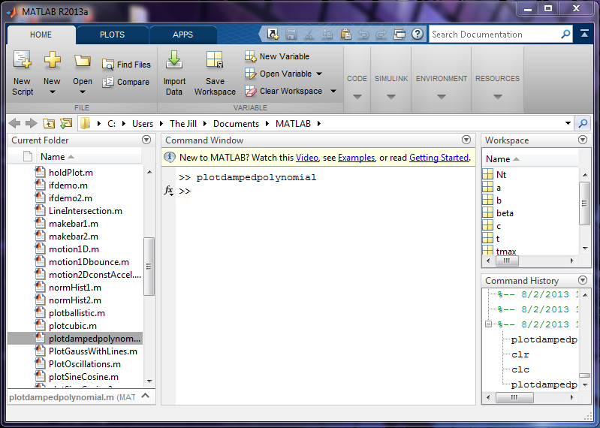
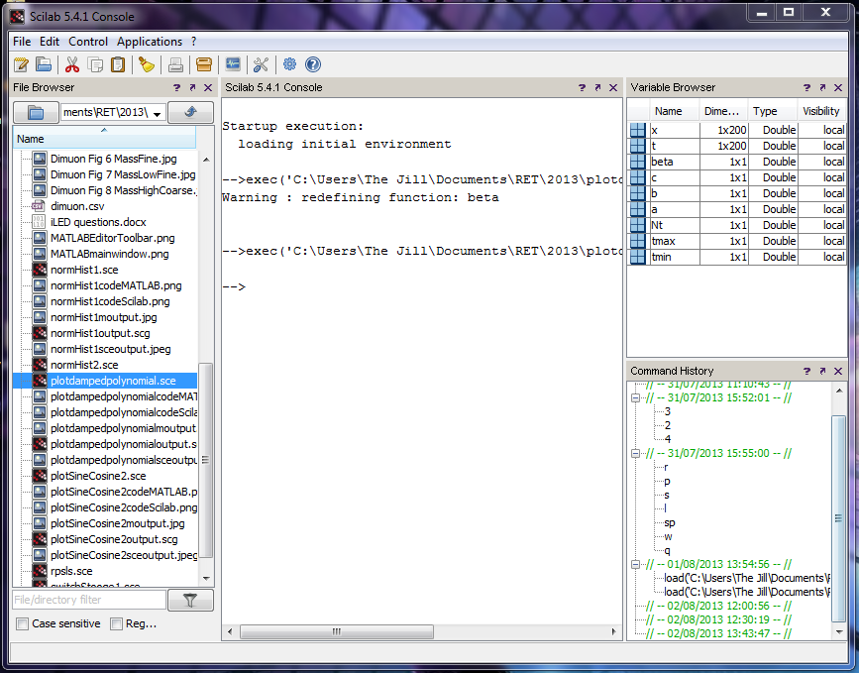
Layout and Workspaces
Very functionally similar
MATLAB has a layout more like the most recent versions of MS Office (icons with explanatory text beneath) while Scilab has the icons alone with explanatory text available by hovering the mouse
Same subwindows
file browser
command window
variable workspace
command history
Both can dock and undock all subwindows in the main window

Slide 12
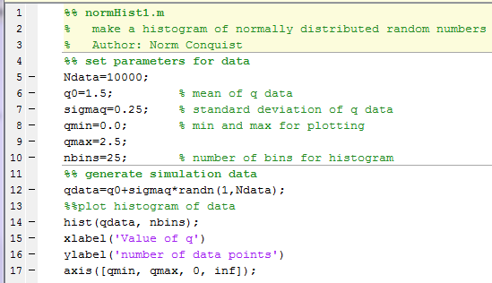
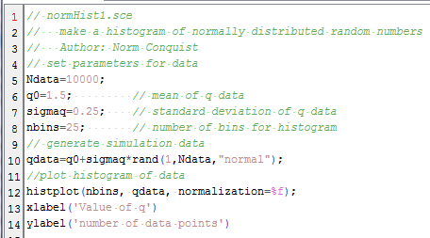
Program Structure, Functions, and Syntax
MATLAB code:
Very closely paralleled
Most structure and functions identical
xlabel and ylabel functions in this example are identical
Some functions with same name but different results
some functions with identical results but different name or syntax
Scilab code:

Slide 13
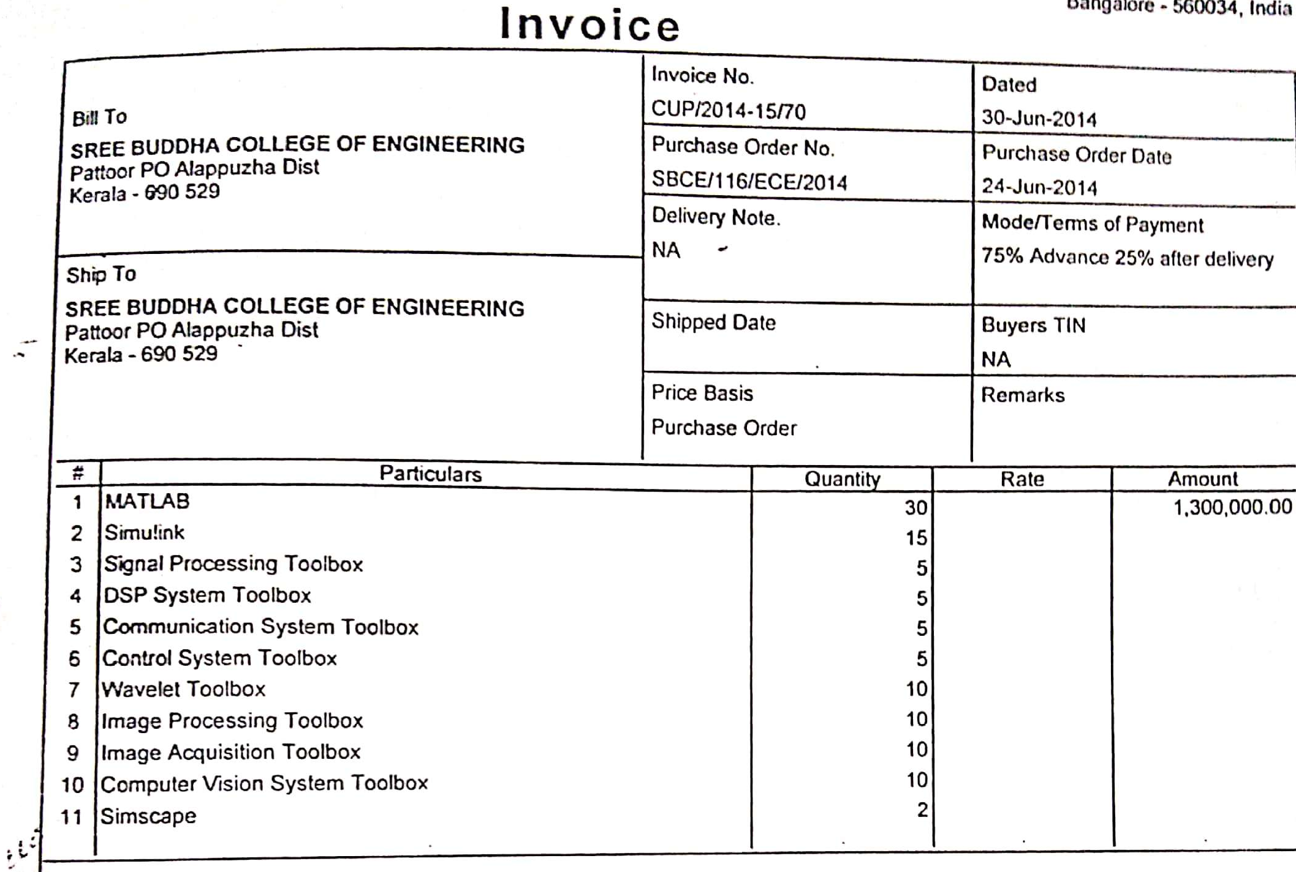

Slide 14
Steps in Scilab Installation
Step 1. Download Scilab
Step 2: Run *.exe file
Step 3: Select the language to be used during the installation process
Step 4: Launch the Scilab Setup Wizard
Step 5: Read the License Agreement
Step 6: Select the installation folder from you local hard
drive and press install
Step 7: Wait for the installation to complete.
Step 8: Launch the application

Slide 15
Introduction to SCILAB (A MATLAB Alternative )

Slide 16
Integrated Development Environment (IDE) of SCILAB
The SCILAB IDE has four windows:
The Console: For calculation works
The Editor: For writing programs
The Graphic Window: For displaying graphs
The Help Window: Its an online/offline window ,where we
can learn SCILAB inbuilt functions in details.

Slide 17
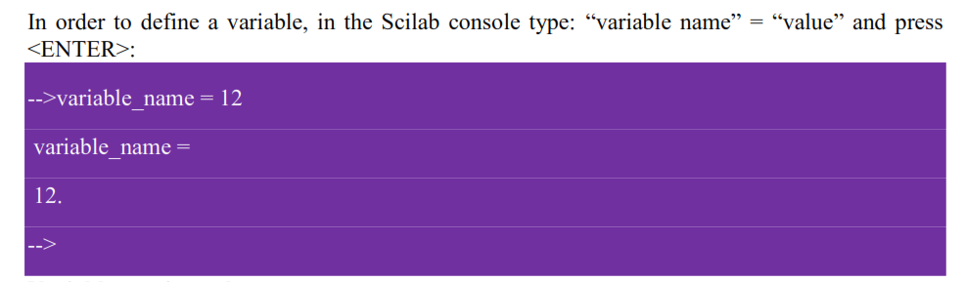
Scilab Variables – naming, real numbers, constants

Slide 18
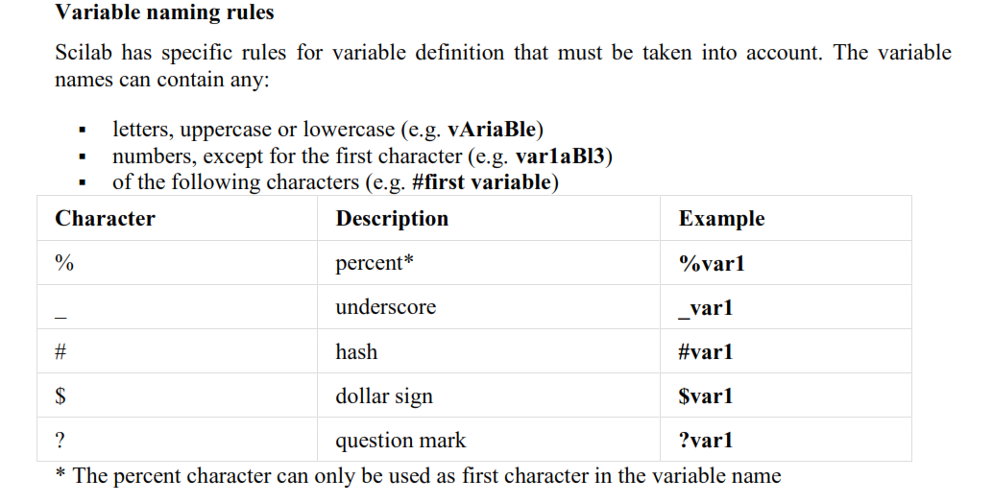

Slide 19
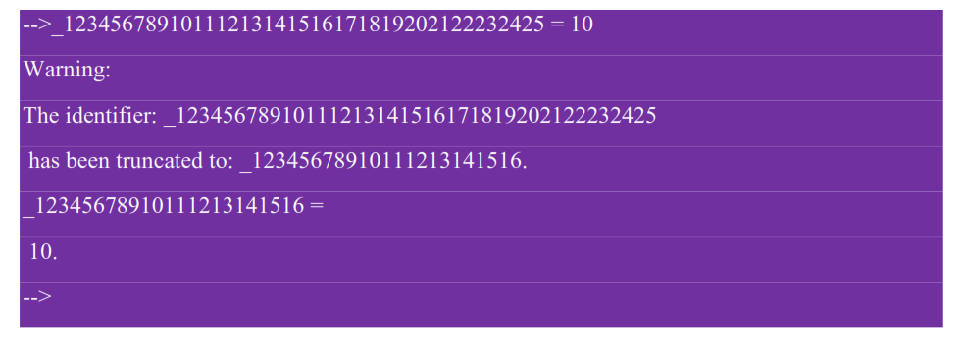
NOTE:

Slide 20
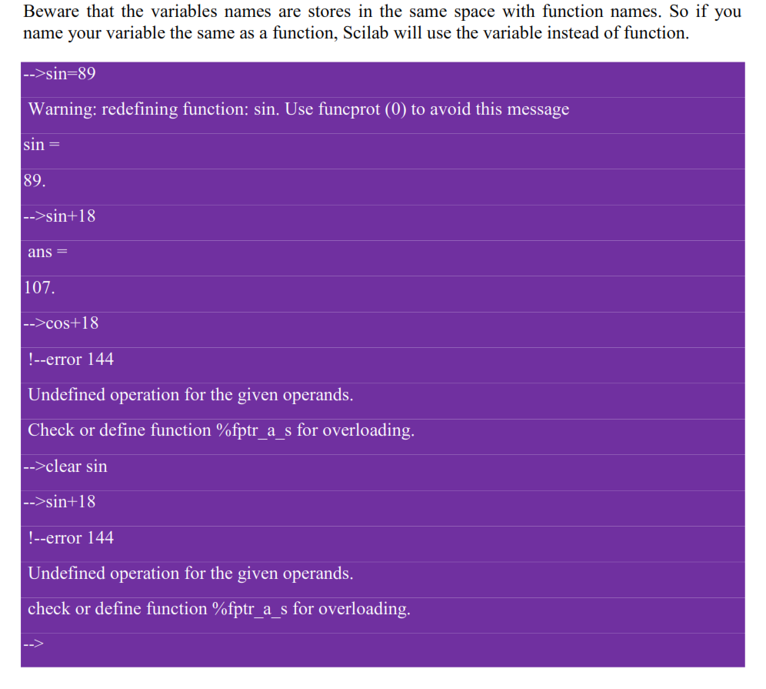

Slide 21
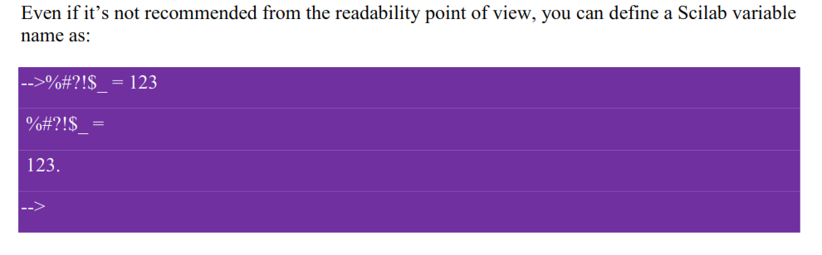
NOTE:

Slide 22
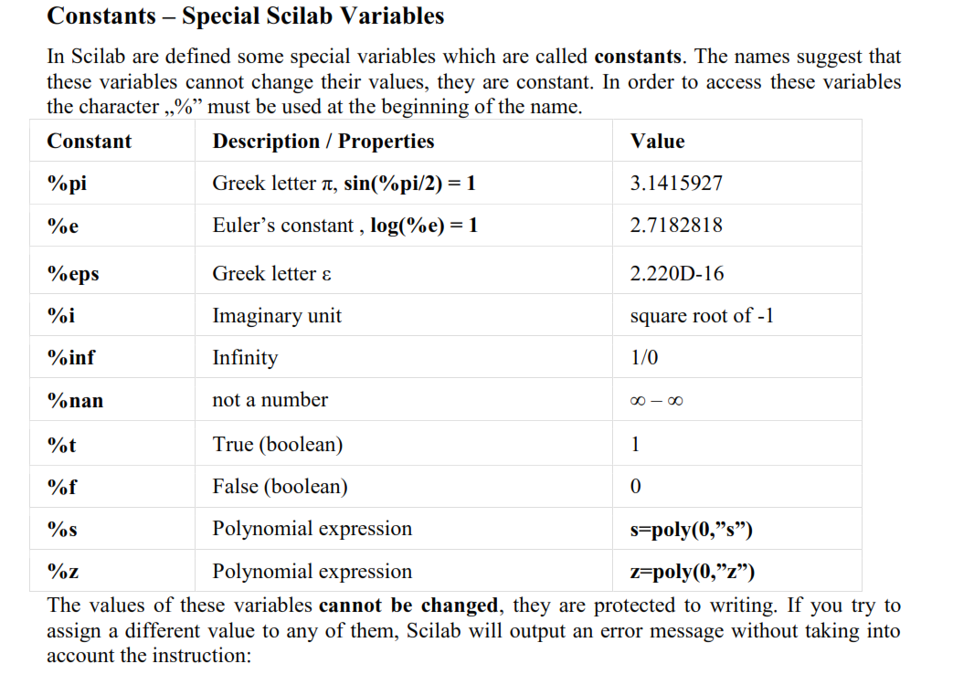

Slide 23
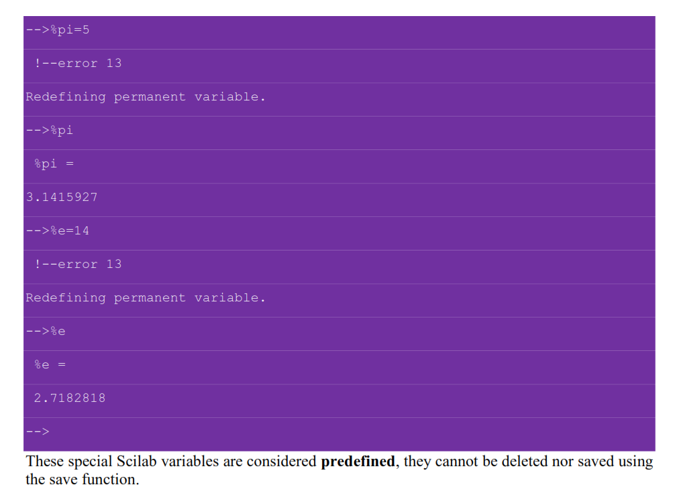

Slide 24
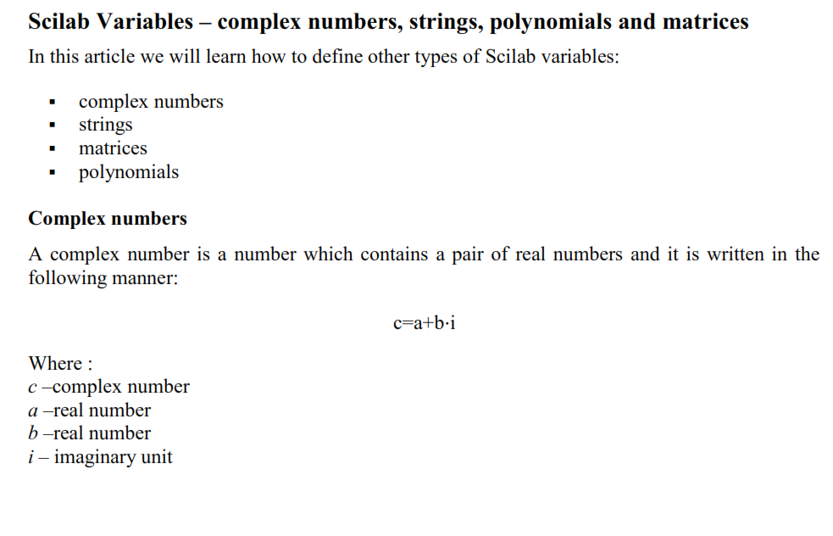

Slide 25
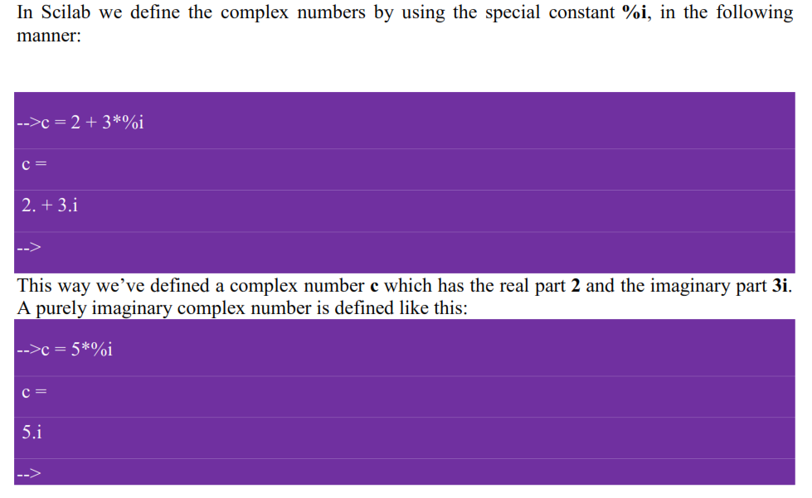

Slide 26
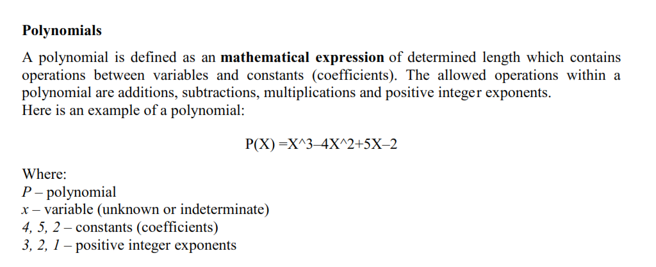

Slide 27
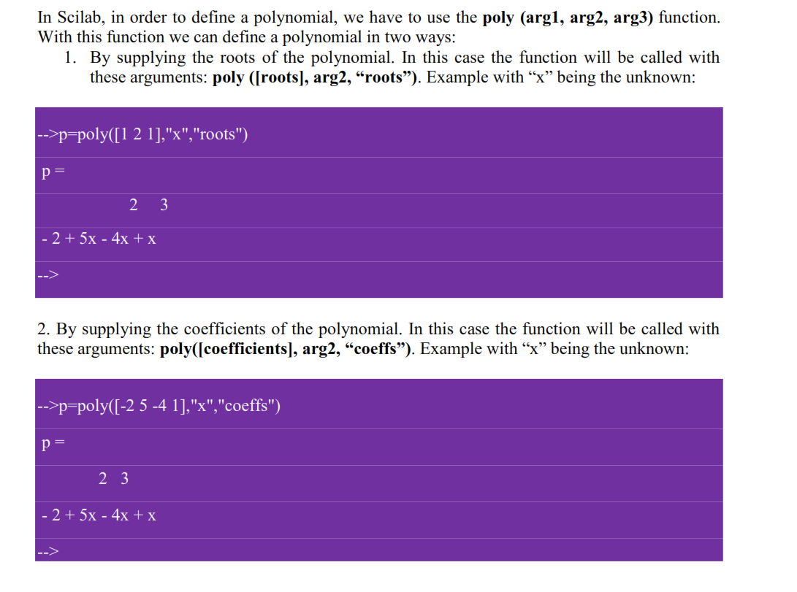

Slide 28
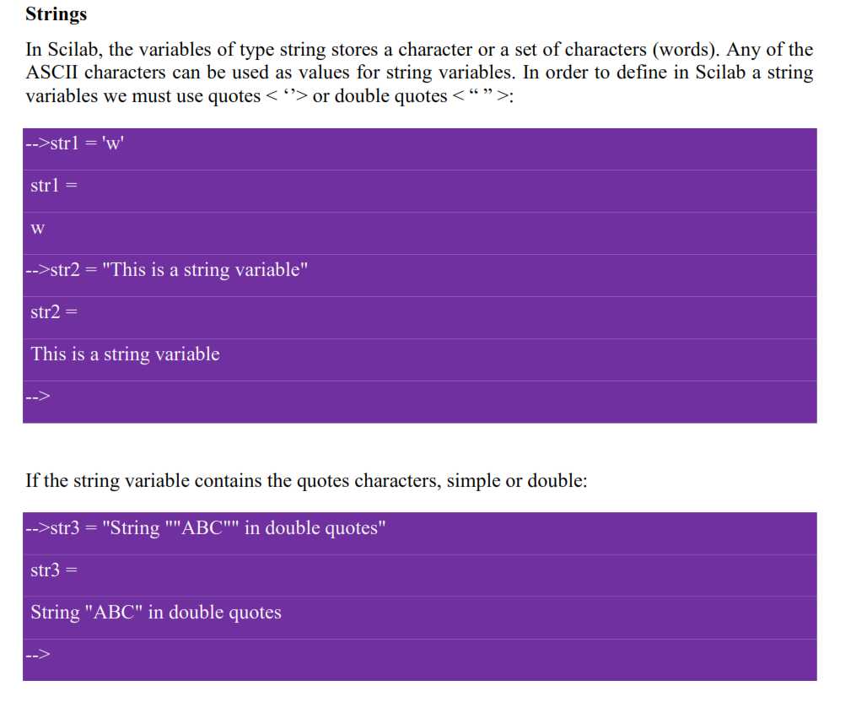

Slide 29
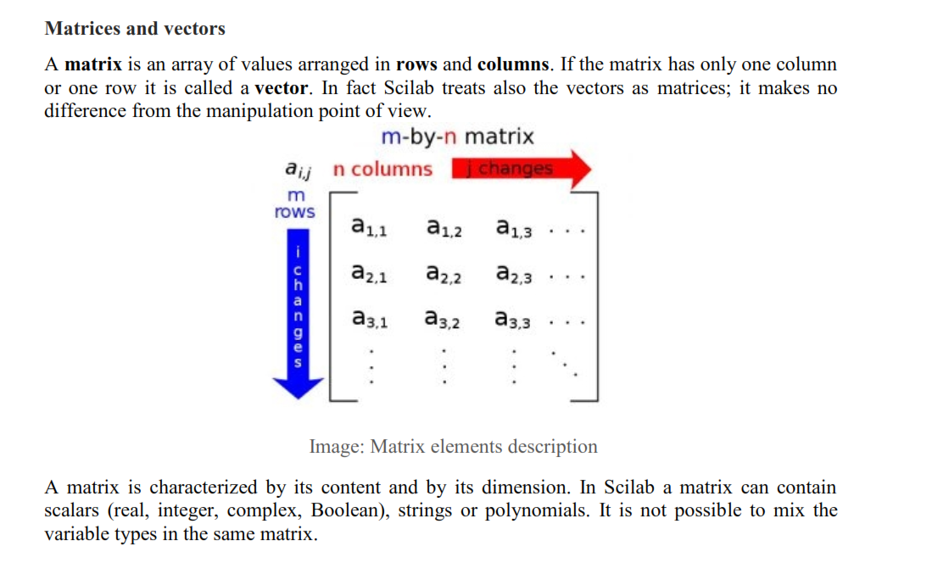

Slide 30
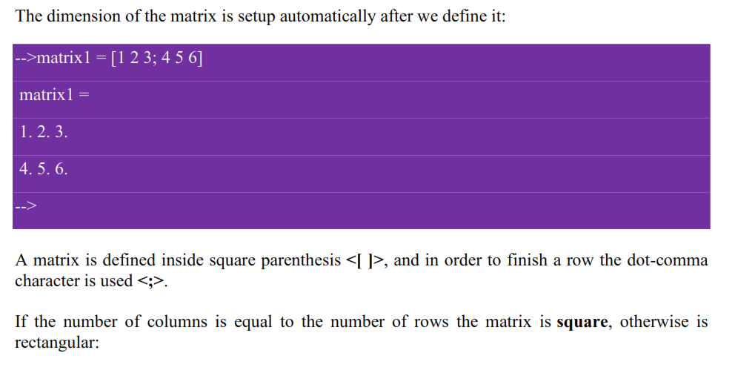

Slide 31
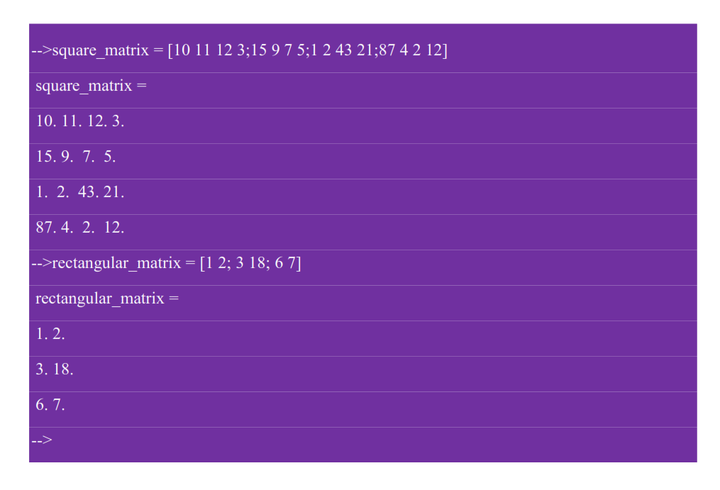

Slide 32
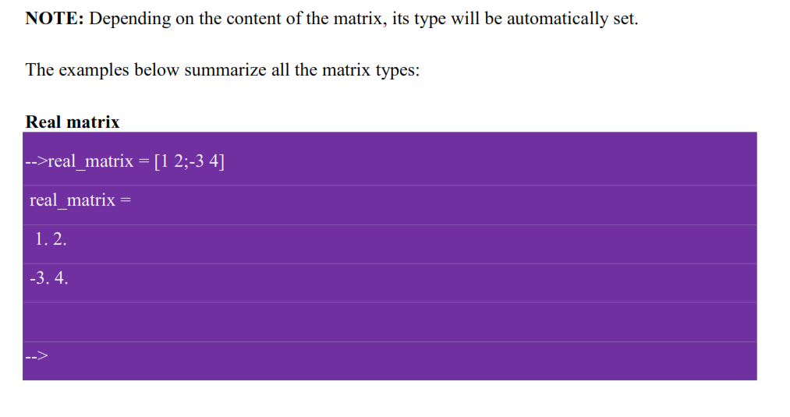

Slide 33
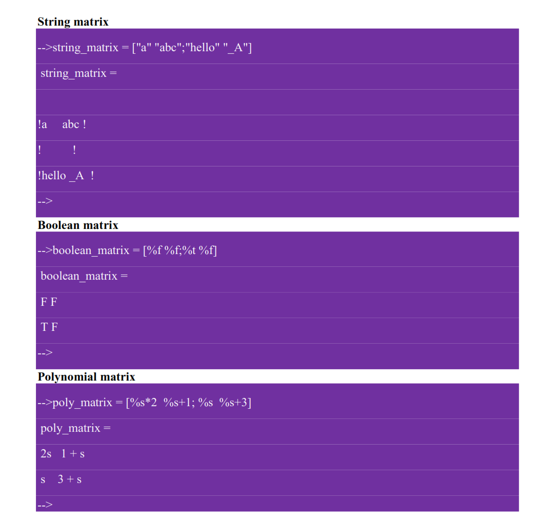

Slide 34
Basic operations on Matrix

Slide 35
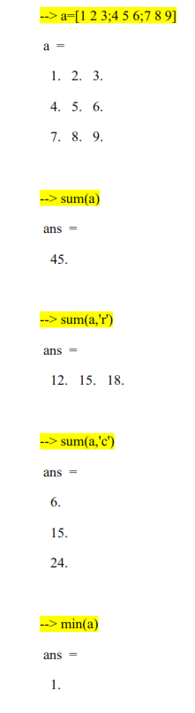
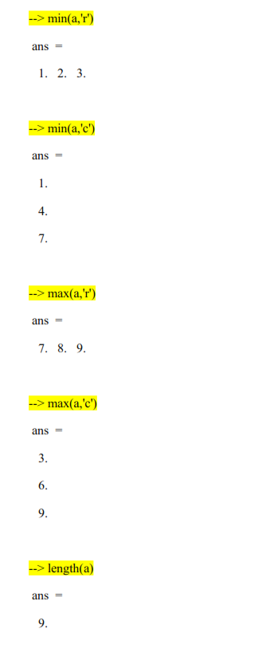

Slide 36
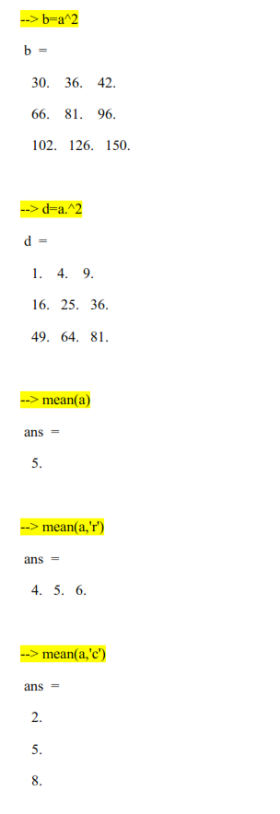
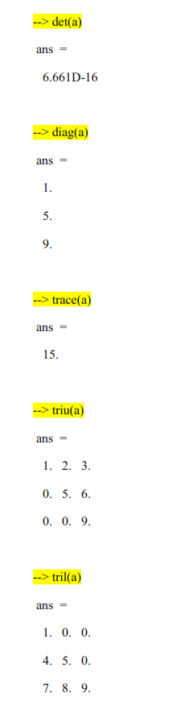

Slide 37
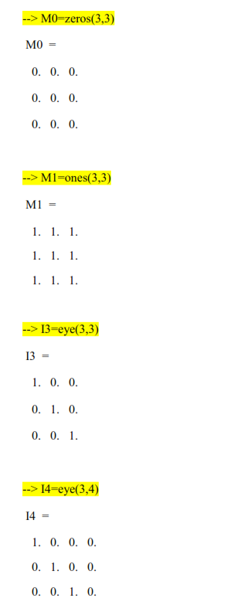
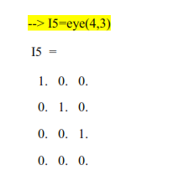

Slide 38
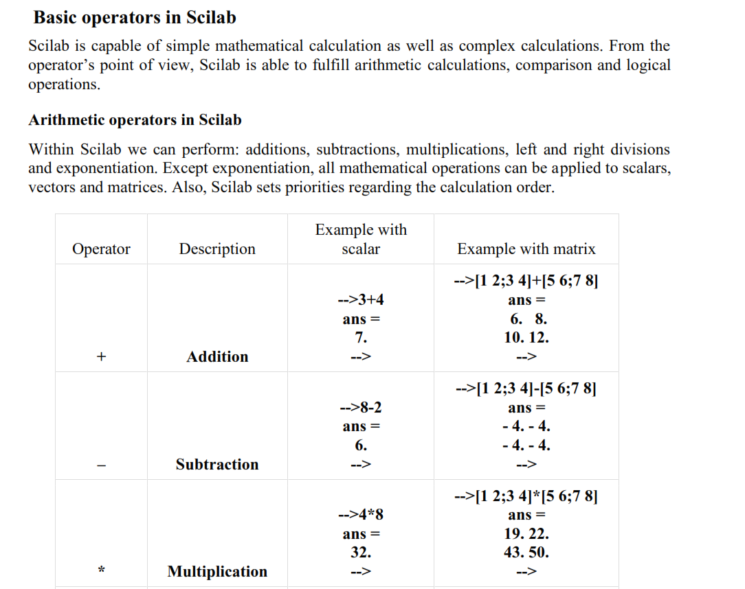

Slide 39
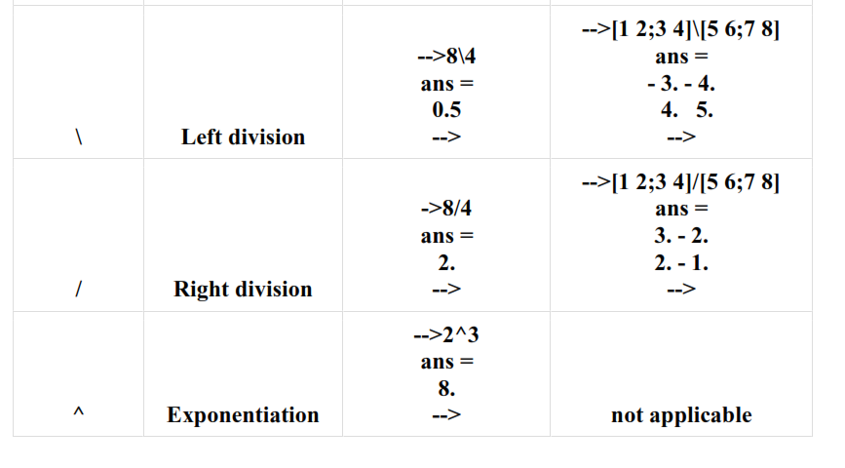

Slide 40
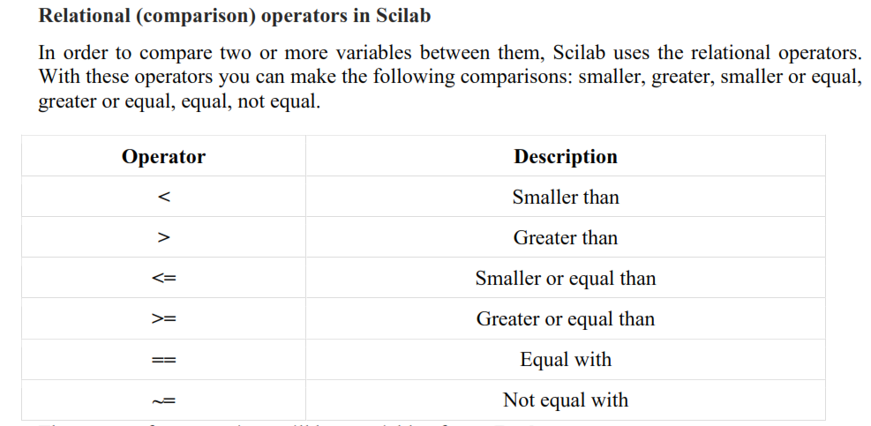

Slide 41
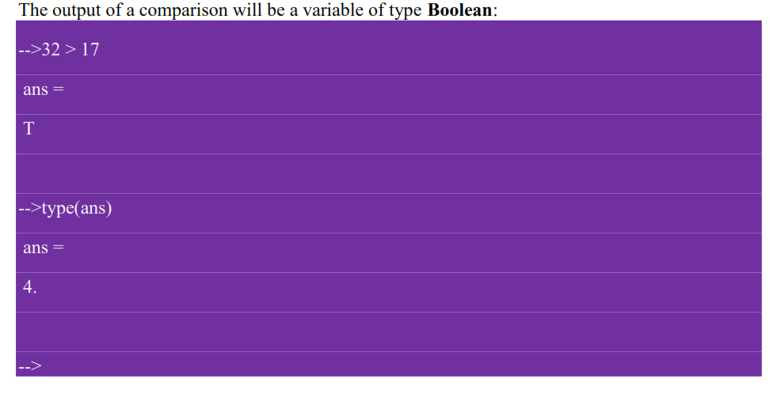

Slide 42
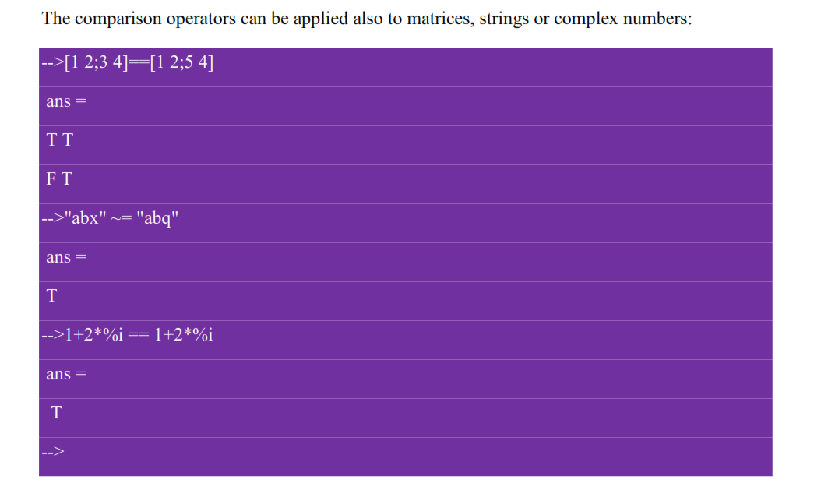

Slide 43
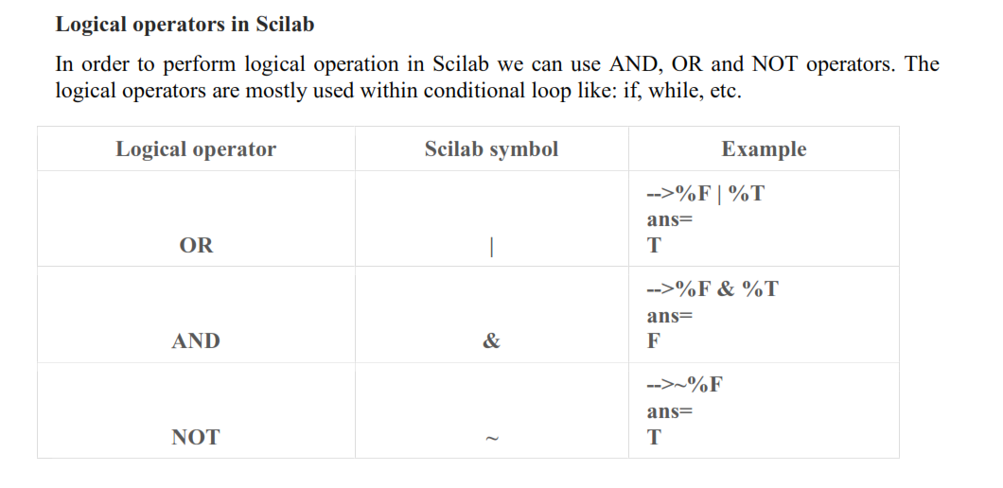

Slide 44
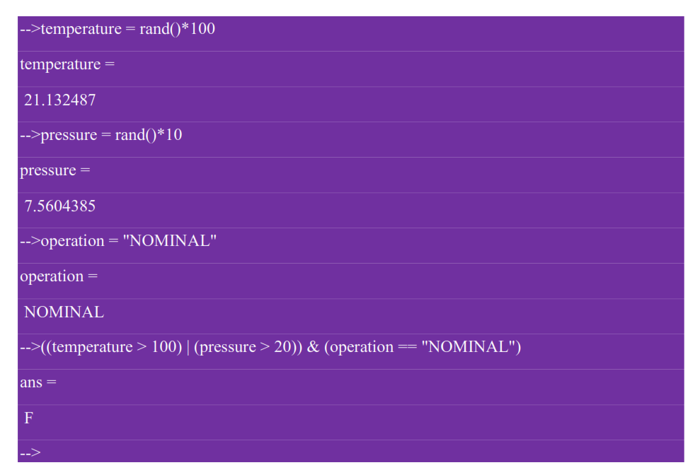

Slide 45
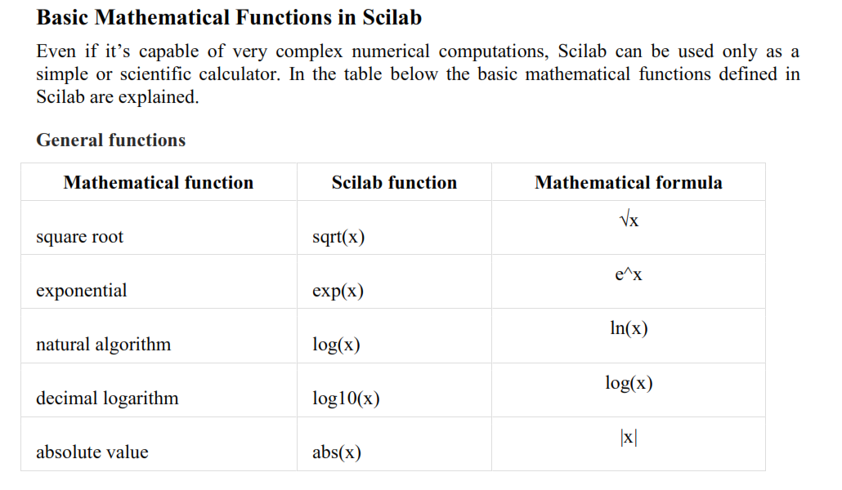

Slide 46
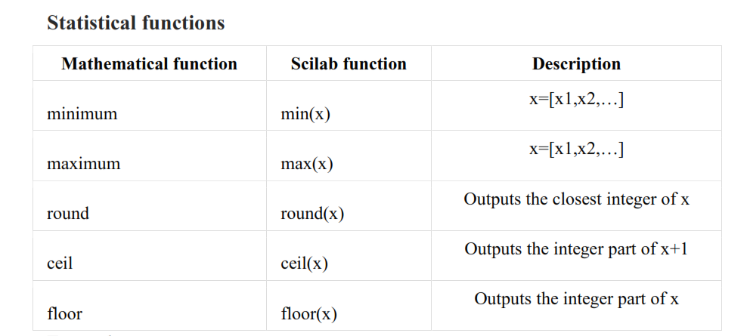

Slide 47
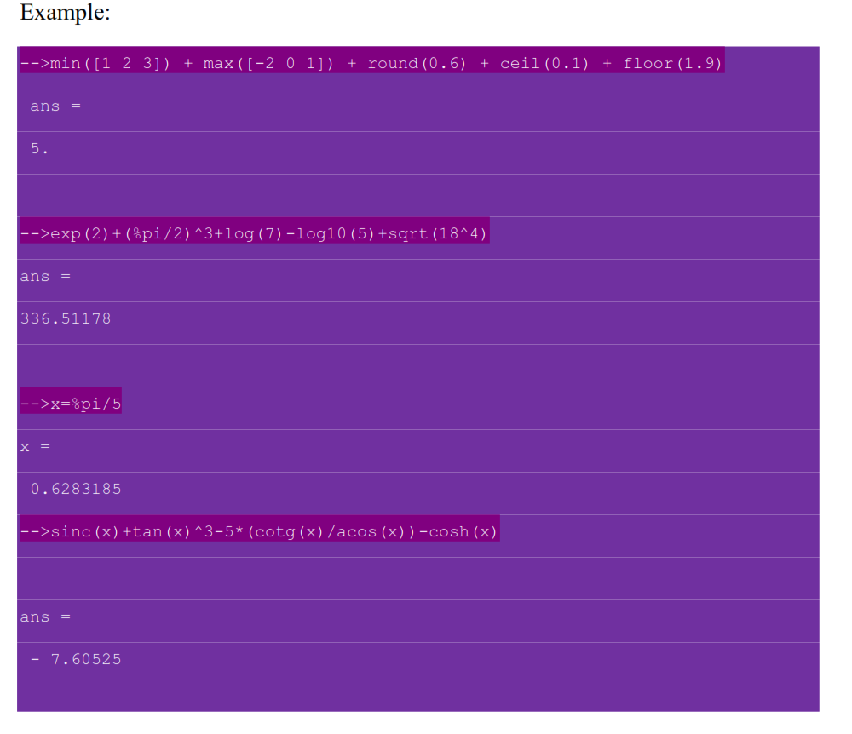

Slide 48
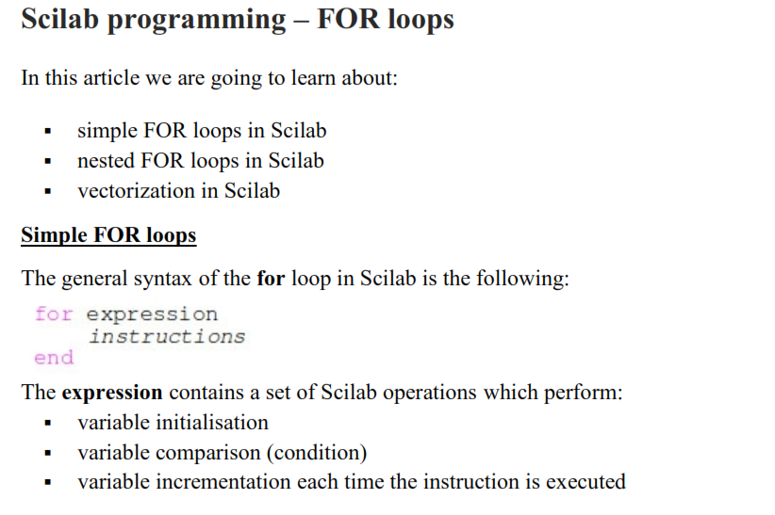
Scilab programming :Introduction to looping concepts

Slide 49
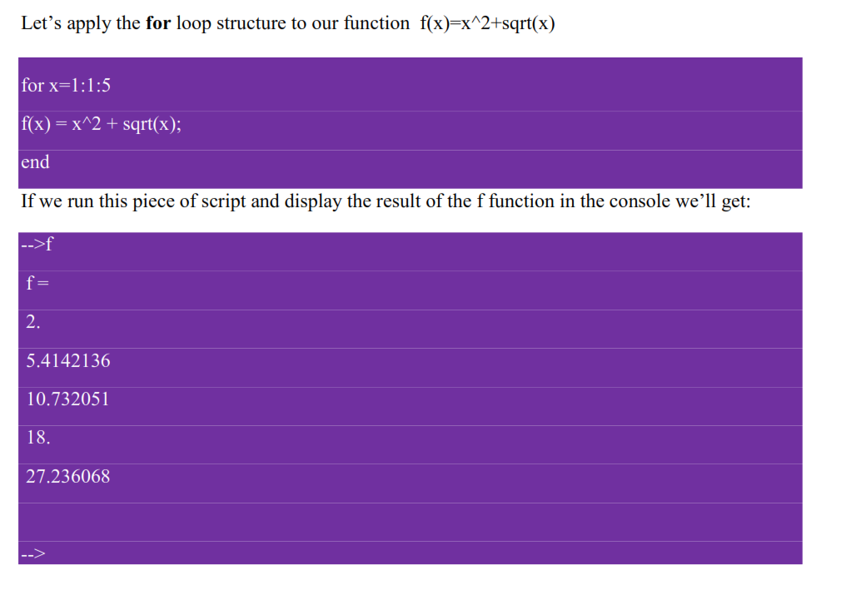

Slide 50
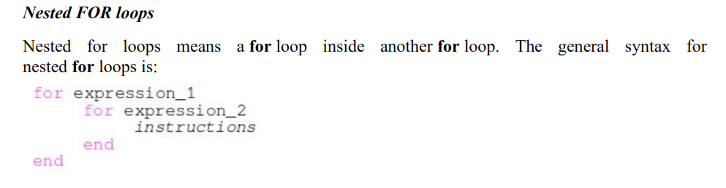

Slide 51
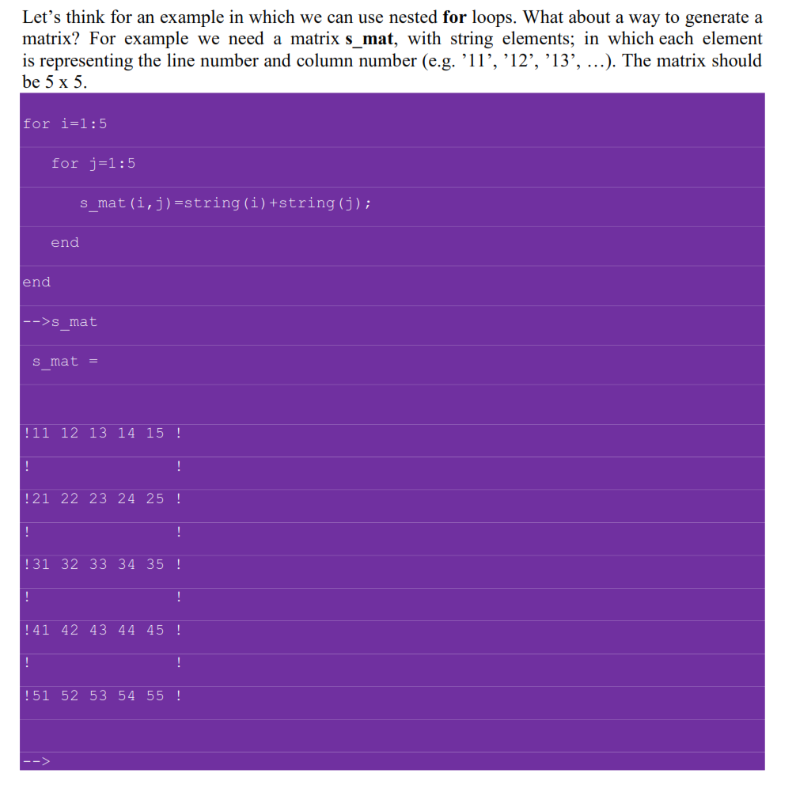

Slide 52
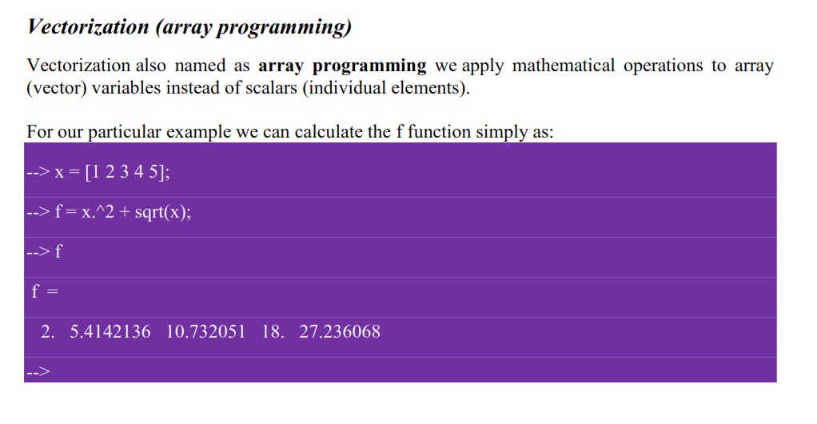

Slide 53
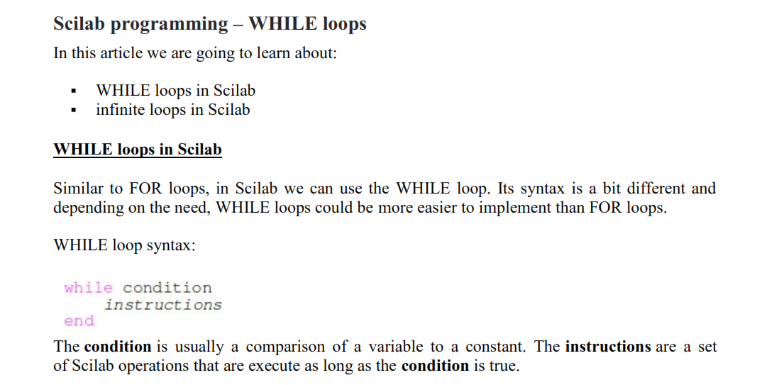

Slide 54


Slide 55



Slide 56


Slide 57


Slide 58




Slide 59



Slide 60


Slide 61


Example:

Slide 62
DIFFERENT METHODS OF VISUALIZING THE OUTPUT

Slide 63


Slide 64



Slide 65


Slide 66


Slide 67


Slide 68


Slide 69

Example:

Slide 70


Slide 71


Slide 72


Slide 73


Slide 74


Slide 75


Slide 76

Ek=1/2mv^2

Slide 77


Slide 78


Slide 79


Slide 80


Slide 81


Slide 82


Slide 83


Slide 84



Slide 85


Slide 86


Slide 87


Slide 88


Slide 89



Slide 90


Slide 91

Solving Linear Algebraic Equations

Slide 92

Using Inbuilt function “linsolve”

Slide 93

Using inverse matrix
X=A^(-1)*b

Slide 94

Common Errors While Using Scilab

Slide 95



Slide 96



Slide 97


Slide 98
Basic programming of various engineering subjects
scilab lab\DSP
scilab lab\LIC
scilab lab\Controlsystem
scilab lab\Analog communication

Slide 99
SCILAB ON CLOUD
On Scilab Cloud, the application runs its algorithms on the server-side and renders the user-interface in any web browser.
This brings new advantages for the deployment of your scientific and simulation applications and scripts:
Centralization of the data used and produced by your application
No software installation on the client-side (no IT headaches)
Hiding the code from the end-users (Intellectual Property protection)
Centralization of the Scilab code for efficient maintenance of the application
https://cloud.scilab.in/

